Slide 1

Verkenning van package stats
en grafische mogelijkheden (kleur).
# in het vervolg typ ik geen prompt meer voor een script

Slide 2
> library(help = "stats")
Information on package ‘stats’
Description:
Package: stats
Version: 3.0.2
Priority: base
Title: The R Stats Package
Author: R Core Team and contributors worldwide
Maintainer: R Core Team <R-core@r-project.org>
Description: R statistical functions
License: Part of R 3.0.2
Built: R 3.0.2; x86_64-w64-mingw32; 2013-09-25 15:39:42 UTC; windows
Dan volgt een index van vijf bladzijden, waaruit ik enkele
items geplukt heb.

Slide 3
Index: (een selectie eruit)
Binomial The Binomial Distribution
Chisquare The (non-central) Chi-Squared Distribution
IQR The Interquartile Range
chisq.test Pearson’s Chi-squared Test for Count Data
lm Fitting Linears Models
lowess Scatter Plot Smoothing
median Median Value
na.action NA Action
na.fail Handle Missing Values in Objects
quantile Sample Quantiles
read.table Manipulate Flat Contingency Tables
sd Standard Deviation
xtabs Cross Tabulation

Slide 4
> ?chisq.test
Description
chisq.test performs chi-squared contingency table tests and goodness-of-fit tests.
Usage
chisq.test(x, y = NULL, correct = TRUE, p = rep(1/length(x), length(x)),
+ rescale.p = FALSE, simulate.p.value = FALSE, B = 2000)
Arguments
x a numeric vector or matrix. x and y can also both be factors.
y a numeric vector; ignored if x is a matrix. If x is a factor, y should be a factor of the same length.

Slide 5
Chisq.test example 1
## Case A. Tabulated data
x <- c(A = 20, B = 15, C = 25)
chisq.test(x)
Chi-squared test for given probabilities
data: x
X-squared = 2.5, df = 2, p-value = 0.2865
chisq.test(as.table(x)) # the same output
data: as.table(x)
X-squared = 2.5, df = 2, p-value = 0.2865

Slide 6
Chisq.test example 2
x <- c(89,37,30,28,2)
p <- c(40,20,20,15,5) # is samen 100 (%)
chisq.test(x, p = p, rescale.p = TRUE)
Chi-squared test for given probabilities
data: x
X-squared = 9.9901, df = 4, p-value = 0.04059

Slide 7
Chisq.test example 3
x <- c(89,37,30,28,2)
p <- c(0.30,0.20,0.20,0.19,0.11)
chisq.test(x, p = p)
Chi-squared test for given probabilities
data: x
X-squared = 39.328, df = 4, p-value = 5.96e-08

Slide 8
Opgave uit periode 2:
Gebied | grootte in are | proportie
1 | 520 | 0,173
2 | 210 | 0,070
3 | 240 | 0,080
4 | 2030 | 0,677
Totaal | 3000 | 1
Totaal 100 herten
Gebied 1 2 3 4
Observed 15 8 23 54
Expected

Slide 9
Chisq.test example 4
x <- c(15,8,23,54) # hier staan de geobserveerde waarden
p <- c(0.173,0.070,0.080,0.677) # hier staan de verwachte verhoudingen
chisq.test(x, p = p)
Chi-squared test for given probabilities
data: x
X-squared = 31.346, df = 3, p-value = 7.187e-07

Slide 10
?matplot
Description
Plot the columns of one matrix against the columns of another.
Usage
matplot(x, y, type = "p", lty = 1:5, lwd = 1, lend = par("lend"),
pch = NULL, col = 1:6, cex = NULL, bg = NA,
xlab = NULL, ylab = NULL, xlim = NULL, ylim = NULL,
..., add = FALSE, verbose = getOption("verbose"))
matpoints(x, y, type = "p", lty = 1:5, lwd = 1, pch = NULL, col = 1:6, ...)
matlines (x, y, type = "l", lty = 1:5, lwd = 1, pch = NULL, col = 1:6, ...)

Slide 11
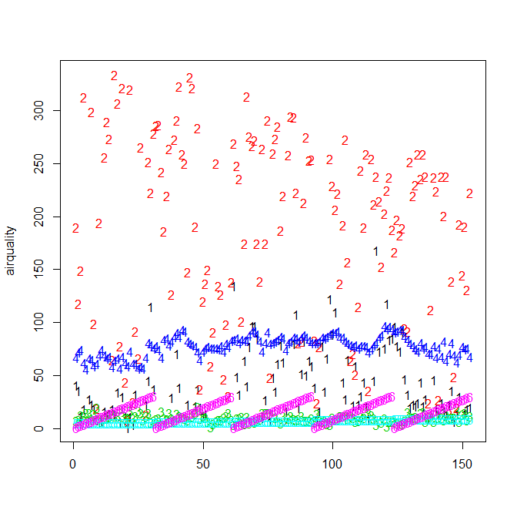
matplot(airquality)

Slide 12
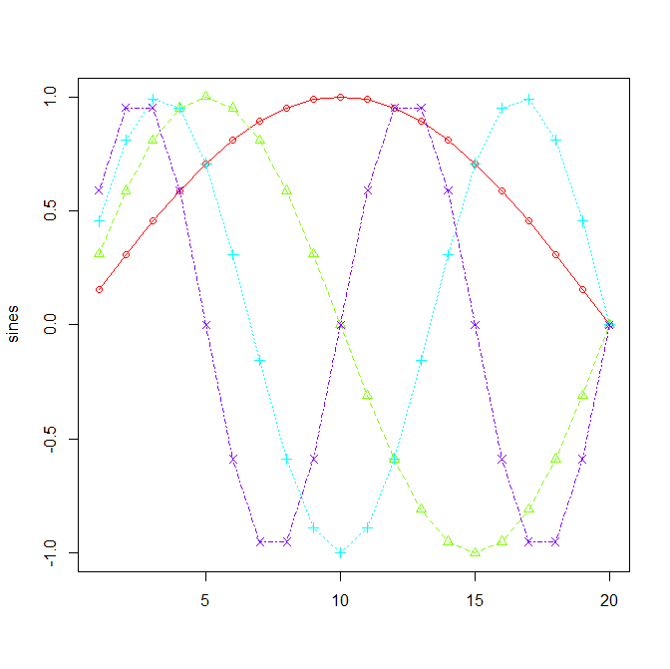
sines <- outer(1:20, 1:4, function(x, y) sin(x / 20 * pi * y))
matplot(sines, pch = 1:4, type = "o", col = rainbow(ncol(sines)))

Slide 13
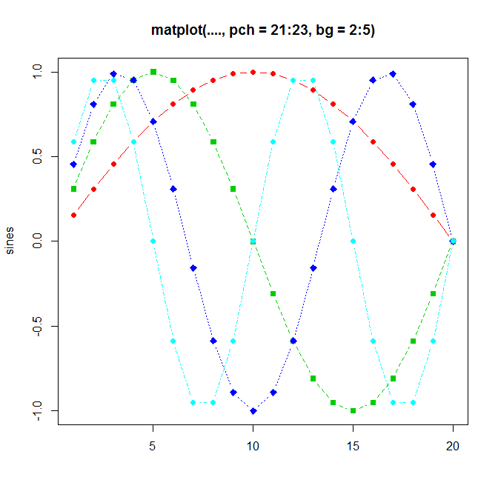
matplot(sines, type = "b", pch = 21:23, col = 2:5, bg = 2:5,
+ main = "matplot(...., pch = 21:23, bg = 2:5)")

Slide 14
require(grDevices)
matplot((-4:5)^2, main = "Quadratic")
# almost identical to plot(*)
sines <- outer(1:20, 1:4, function(x, y) sin(x / 20 * pi * y))
matplot(sines, pch = 1:4, type = "o", col = rainbow(ncol(sines)))
matplot(sines, type = "b", pch = 21:23, col = 2:5, bg = 2:5,
+ main = "matplot(...., pch = 21:23, bg = 2:5)")

Slide 16
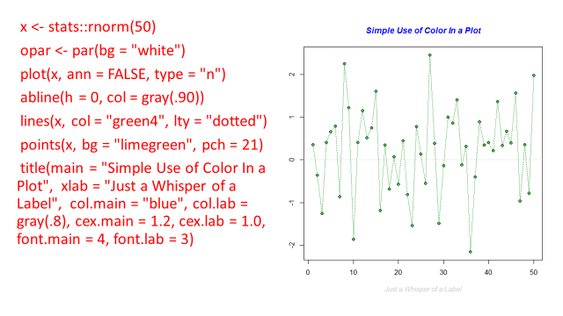

Slide 17
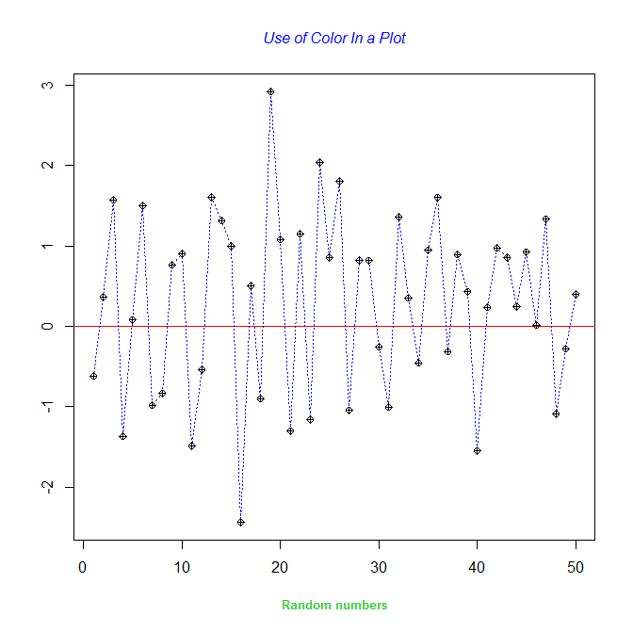
x <- stats::rnorm(50)
opar <- par(bg = "white")
plot(x, ann = FALSE, type = "n")
abline(h = 0, col ="red")
lines(x, col = "blue", lty = "dotted")
points(x, bg = "yellow", pch = 10)
title(main = "Use of Color In a Plot", xlab = "Random numbers", col.main = "blue", col.lab = "limegreen", cex.main = 1.0, cex.lab = 0.8, font.main = 3, font.lab = 2)

Slide 18
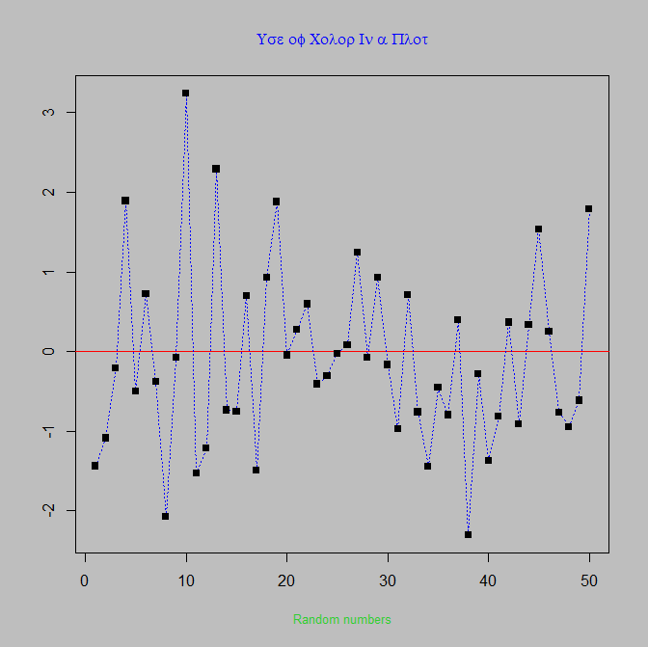
x <- stats::rnorm(50)
opar <- par(bg = "grey")
plot(x, ann = FALSE, type = "n")
abline(h = 0, col ="red")
lines(x, col = "blue", lty = "dotted")
points(x, bg = "white", pch = 15)
title(main = "Use of Color In a Plot", xlab = "Random numbers", col.main = "blue", col.lab = "limegreen", cex.main = 1.0, cex.lab = 0.8, font.main = 5, font.lab = 1)

